Slide 1
From ARTWORK to FILE and back to THE ARTWORK
Francesca Colussi
@FraKeba
Ana Ribeiro
@wranaribeiro

Slide 2
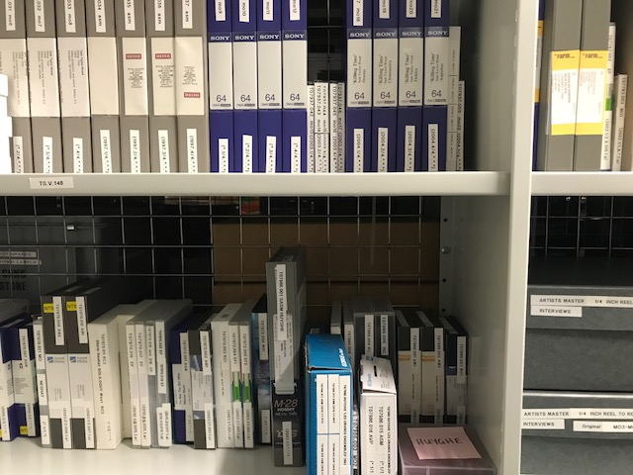
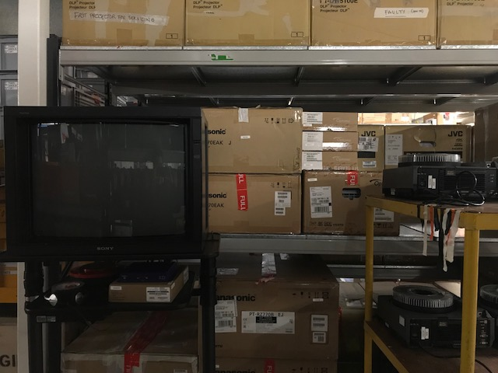
Context
Tate Tibm collection approx. 750 artworks
Tibm ARTWORK is made of different components that live in storage
Components are reunited in the display ⇒ ARTWORK!
Context of the display determines
Exhibition Format File
Master File ⇒ Exhibition Format File

Slide 3
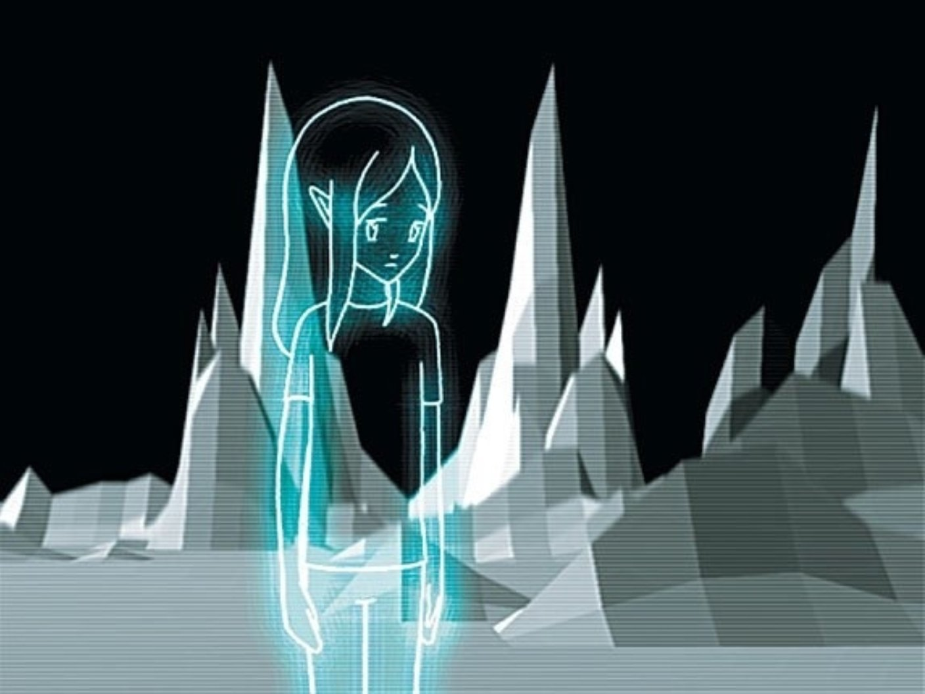
No Ghost Just a Shell

Slide 4
No Ghost Just a Shell
Tanks display 2018

Slide 5
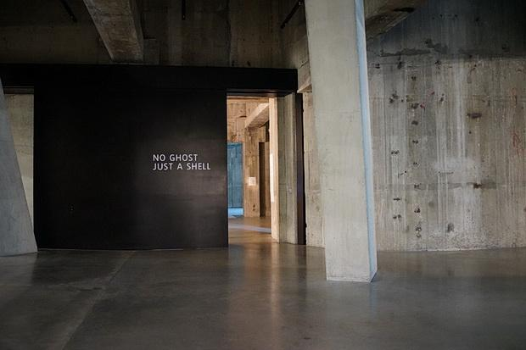

Slide 6
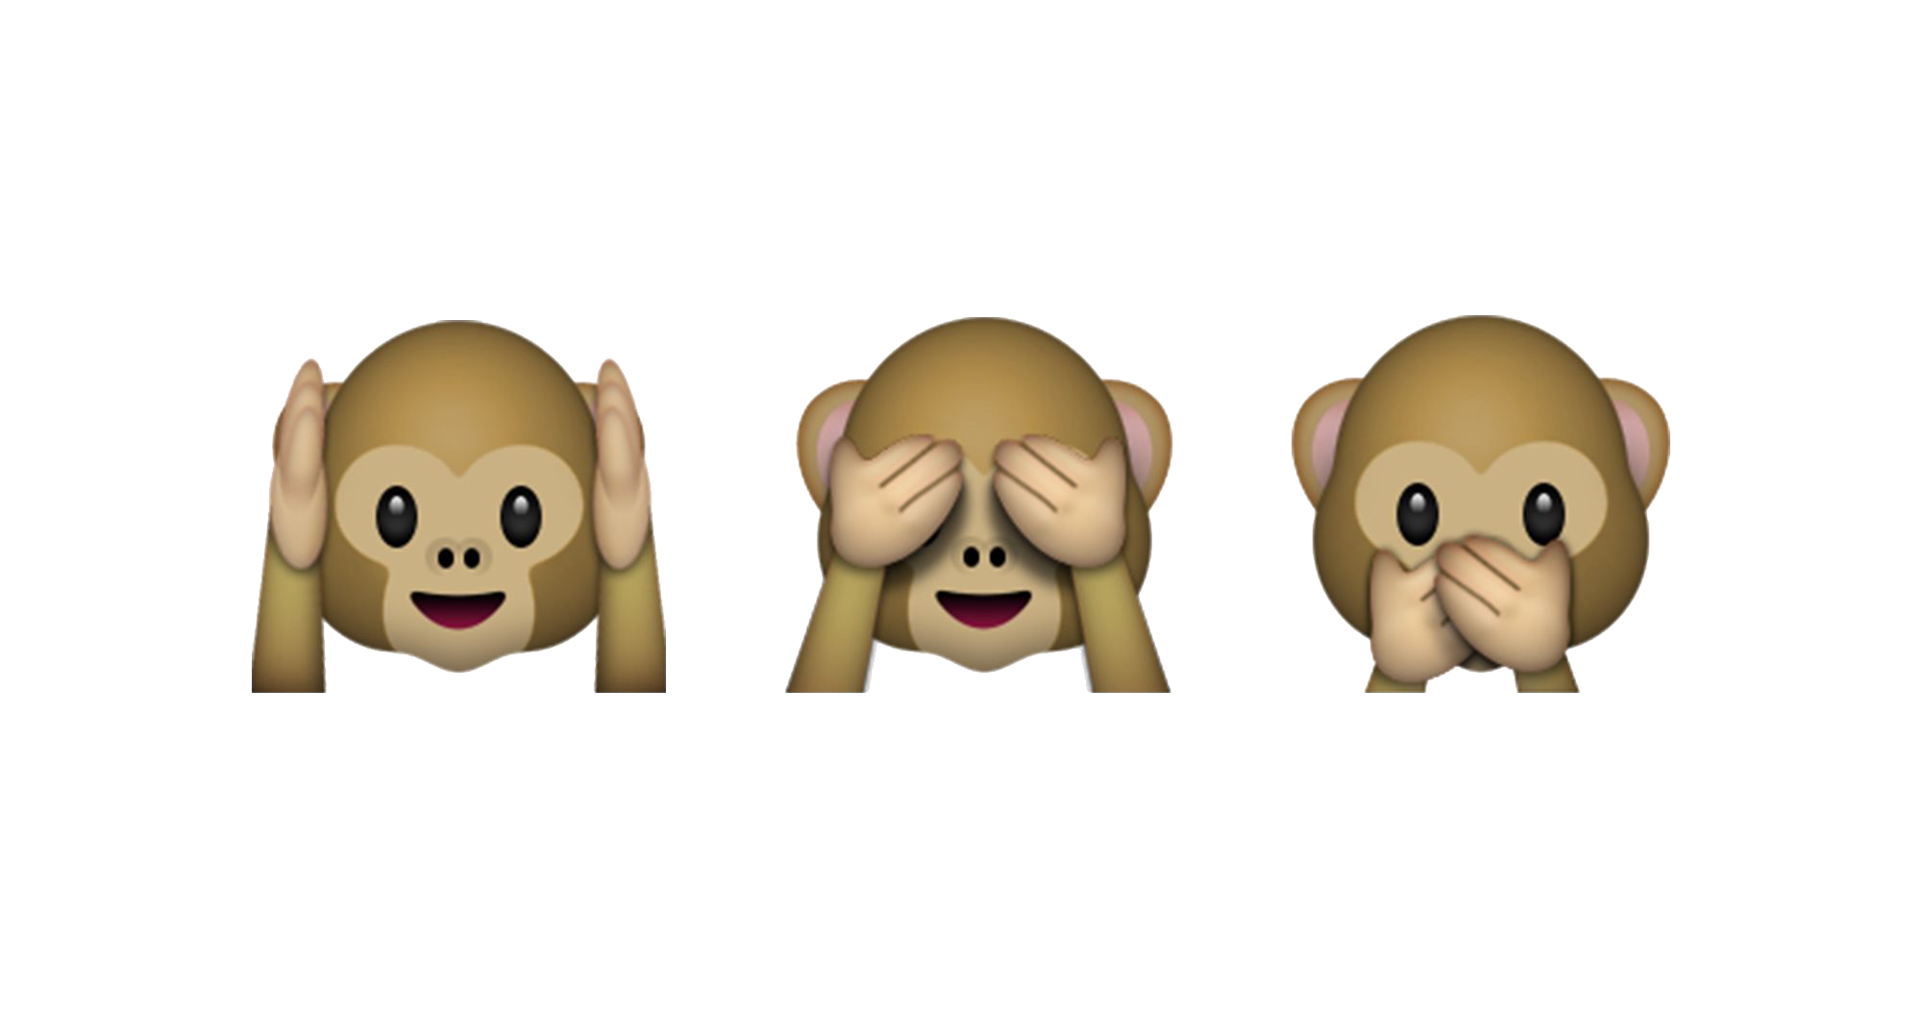
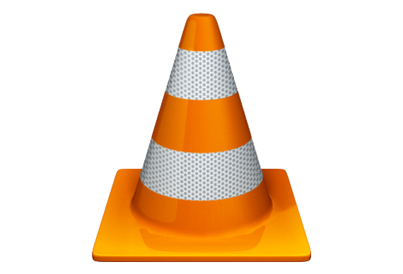
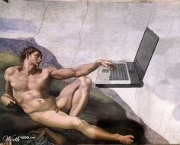
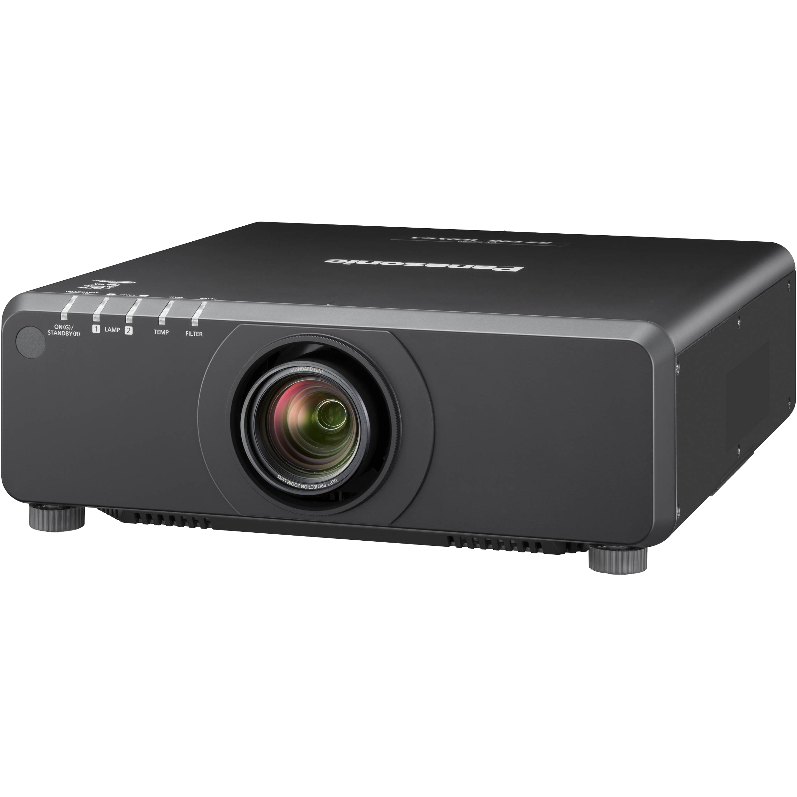
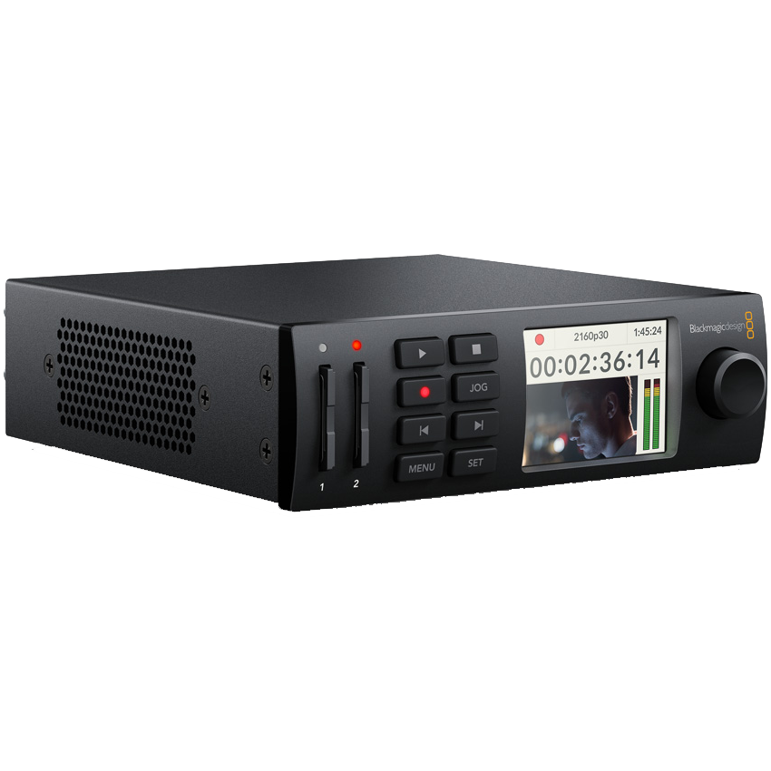
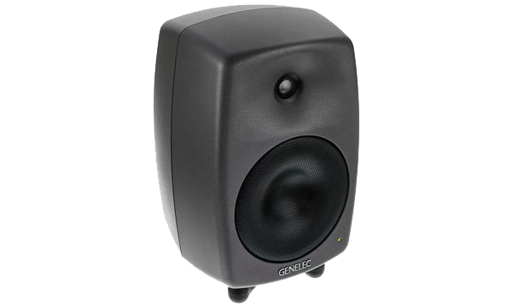
Observe the artwork and its history and look for clues
Analyze the files and their relationship with the equipment
Listen, watch, compare and ask for help and opinions
Reach out
Documentation of media prep for Whitney loan in 2016

Slide 7
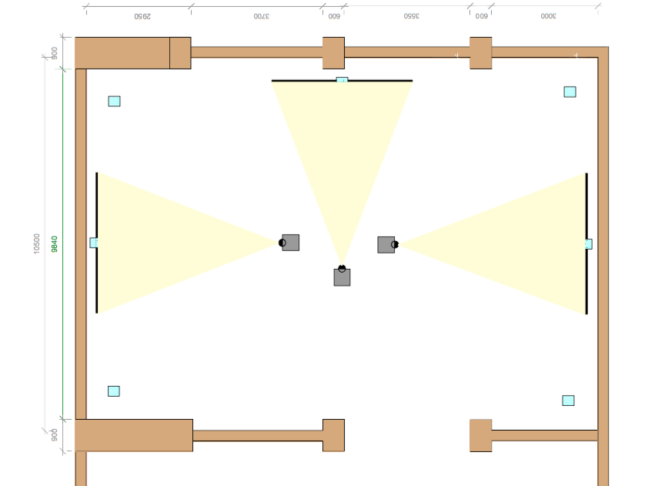
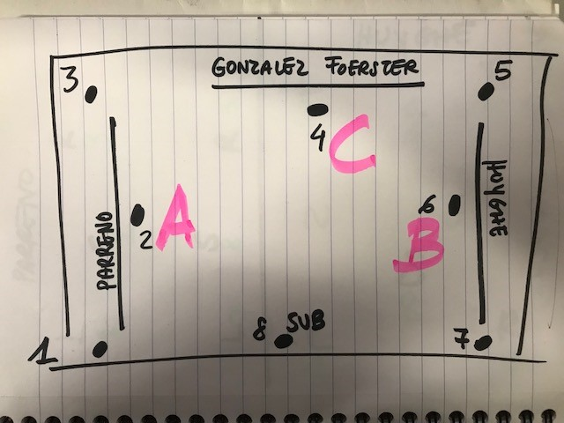
Gallery layout

Slide 8
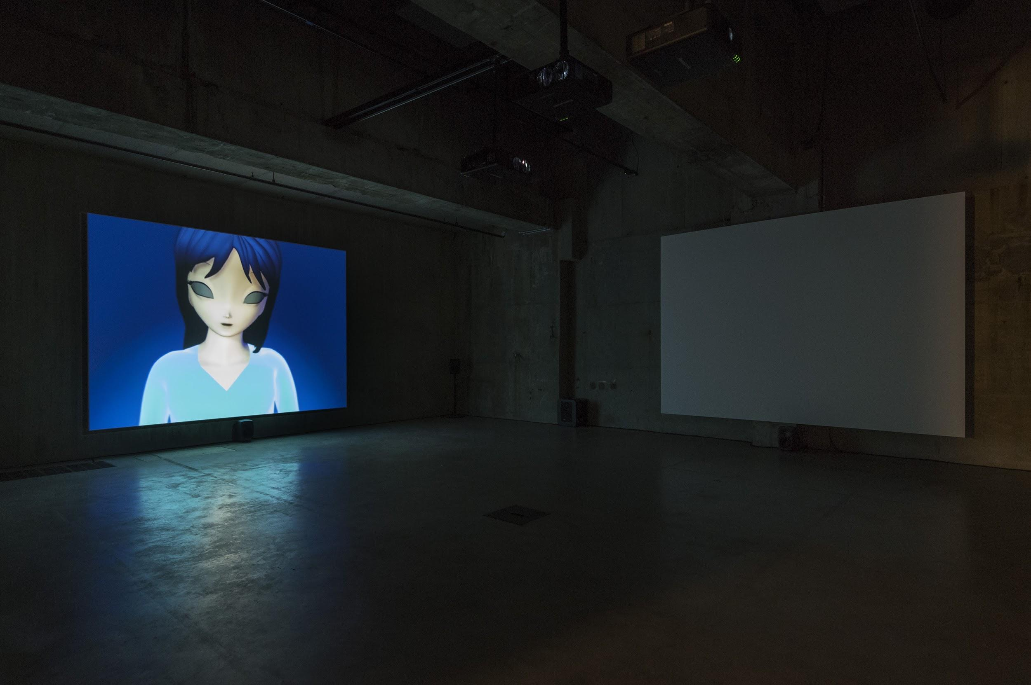
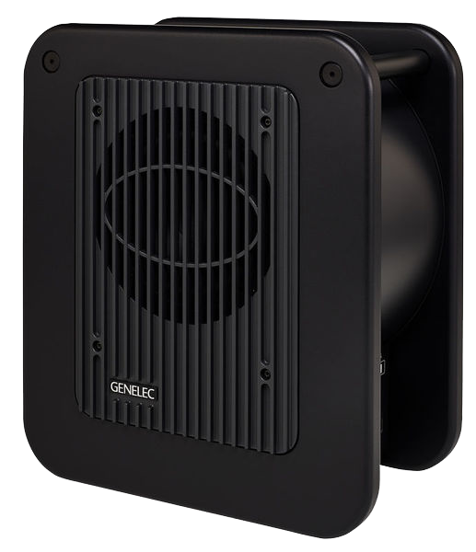
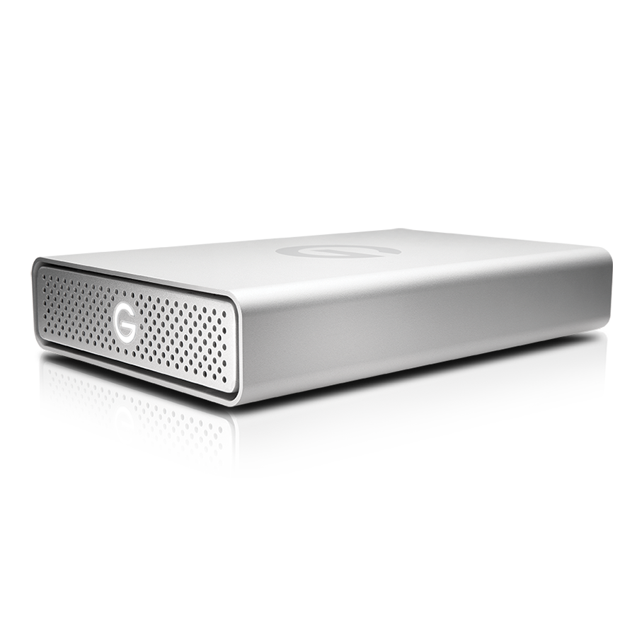
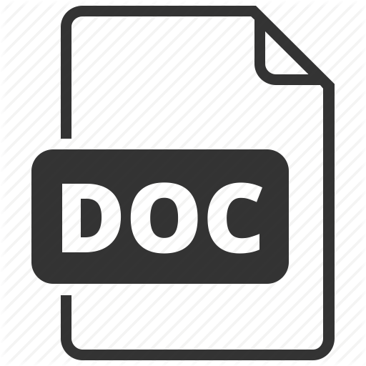

Slide 9
Media Prep for the display
what we discovered in the process
The 3 video files don’t have the same framerate but we needed to combine them in one timeline and assure correct playback
Although it was not explicit from the specs there was no way to get the Hyperdeck to play a 4:3 video!
We had 4:3 .mpeg and .mp4 files and needed to create 16:9 ProRes for compatibility issues with Hyperdecks … the selected projectors were 4:3 though! Agh!
In order to output 8 channels of audio via SDI on Hyperdeck we had to create a 16 channel multitrack.

Slide 10
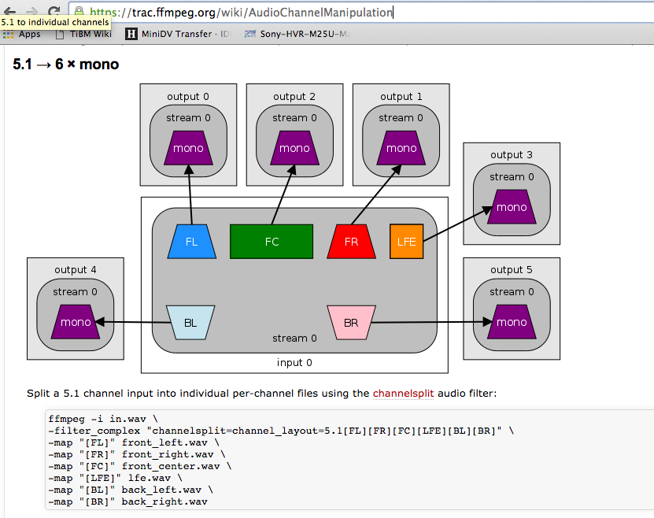
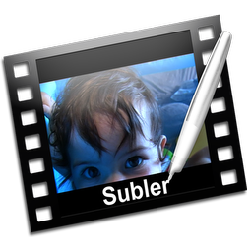

Slide 11
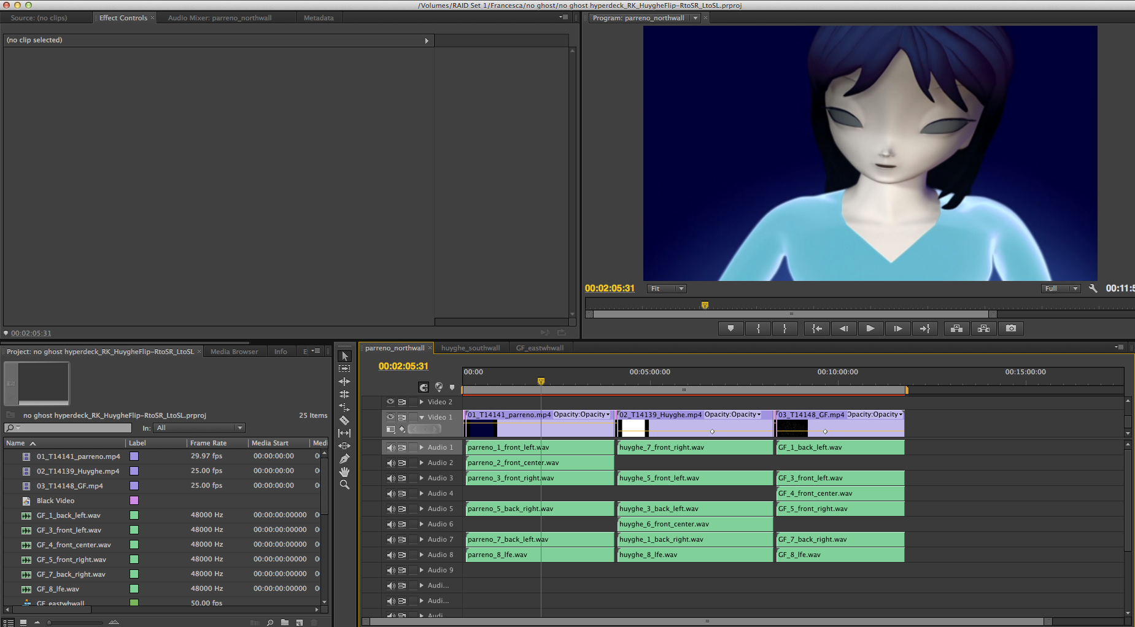

Slide 12
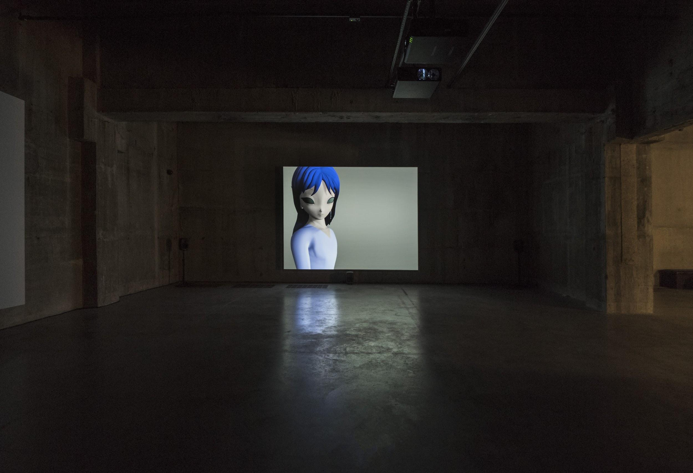

Slide 13
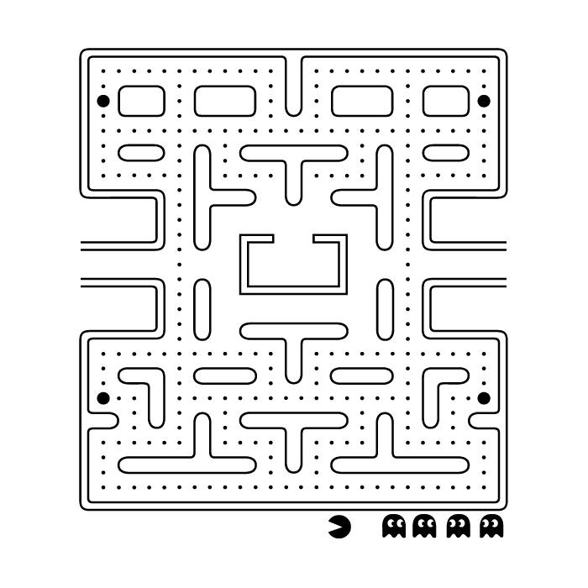
Media Prep summary
MASTER
EXHIBITION FORMAT
DETOURS

Slide 14
How are we documenting the decision making process?

Slide 15
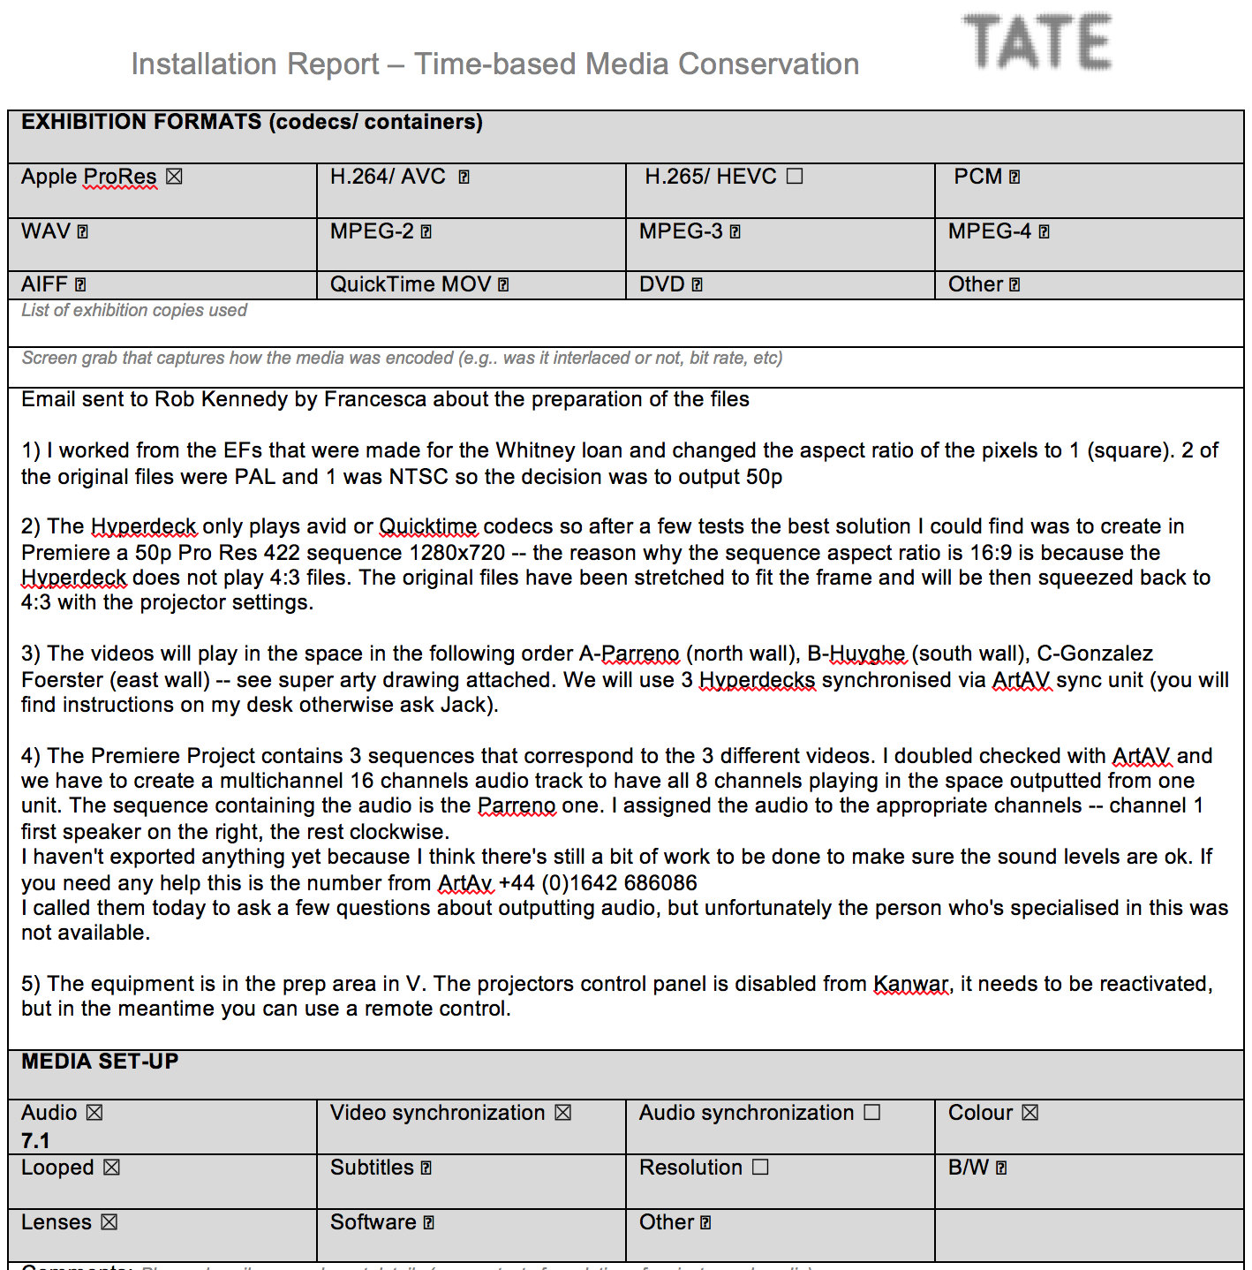
Installation Report
Context
Audiovisual
Equipment
Exhibition formats
Media set-up
Decision making
Relates this specific display back to the artwork.

Slide 16
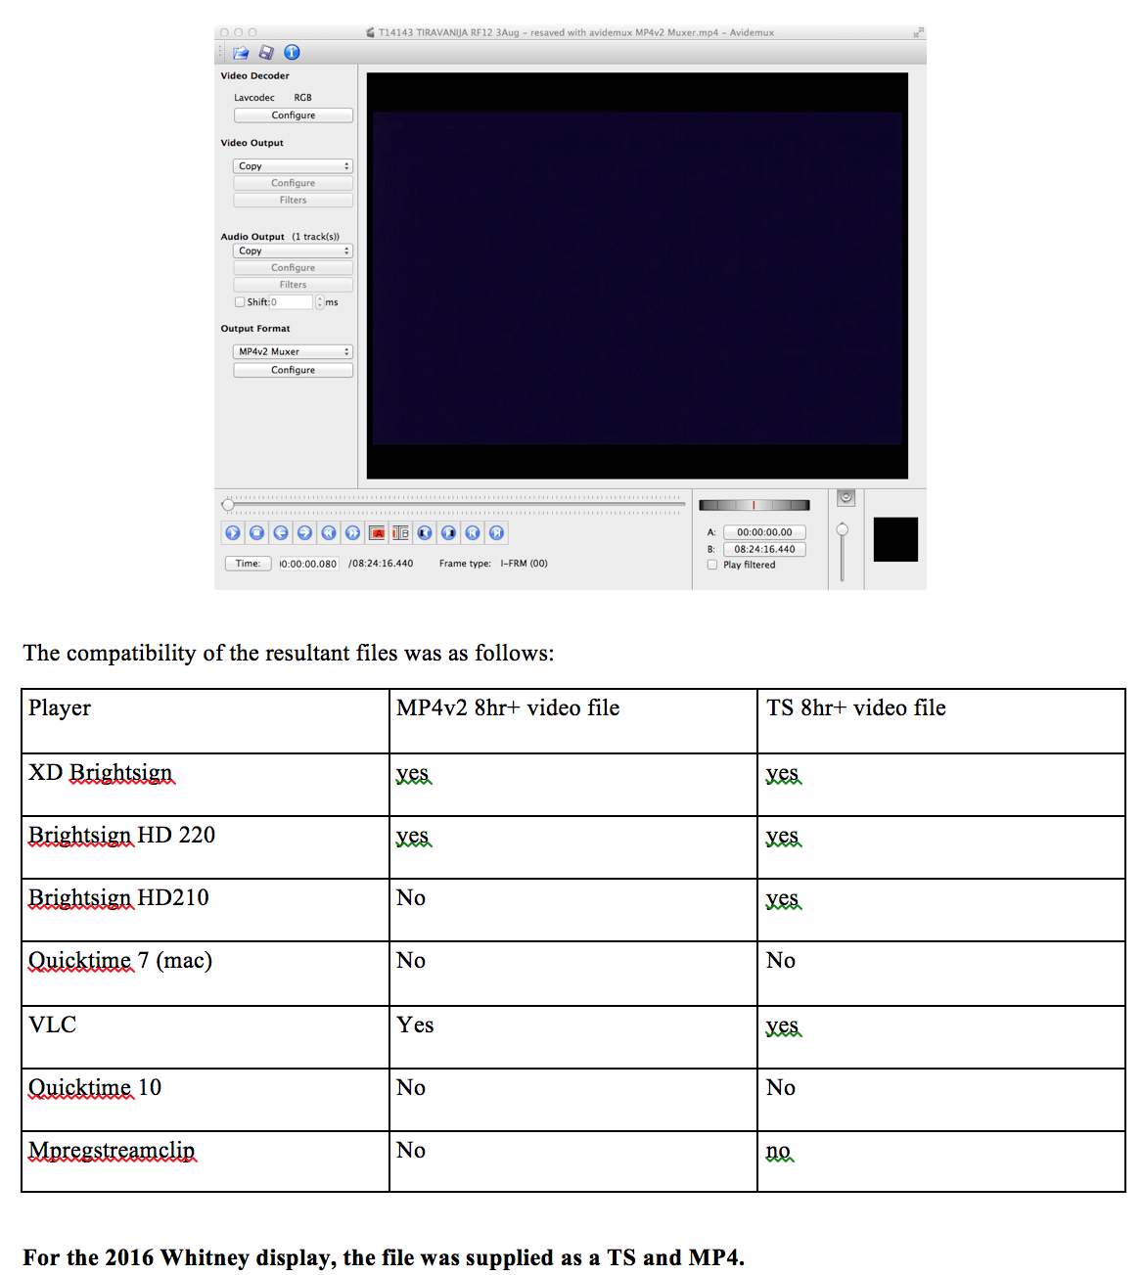
Screenshots of tools used

Slide 17
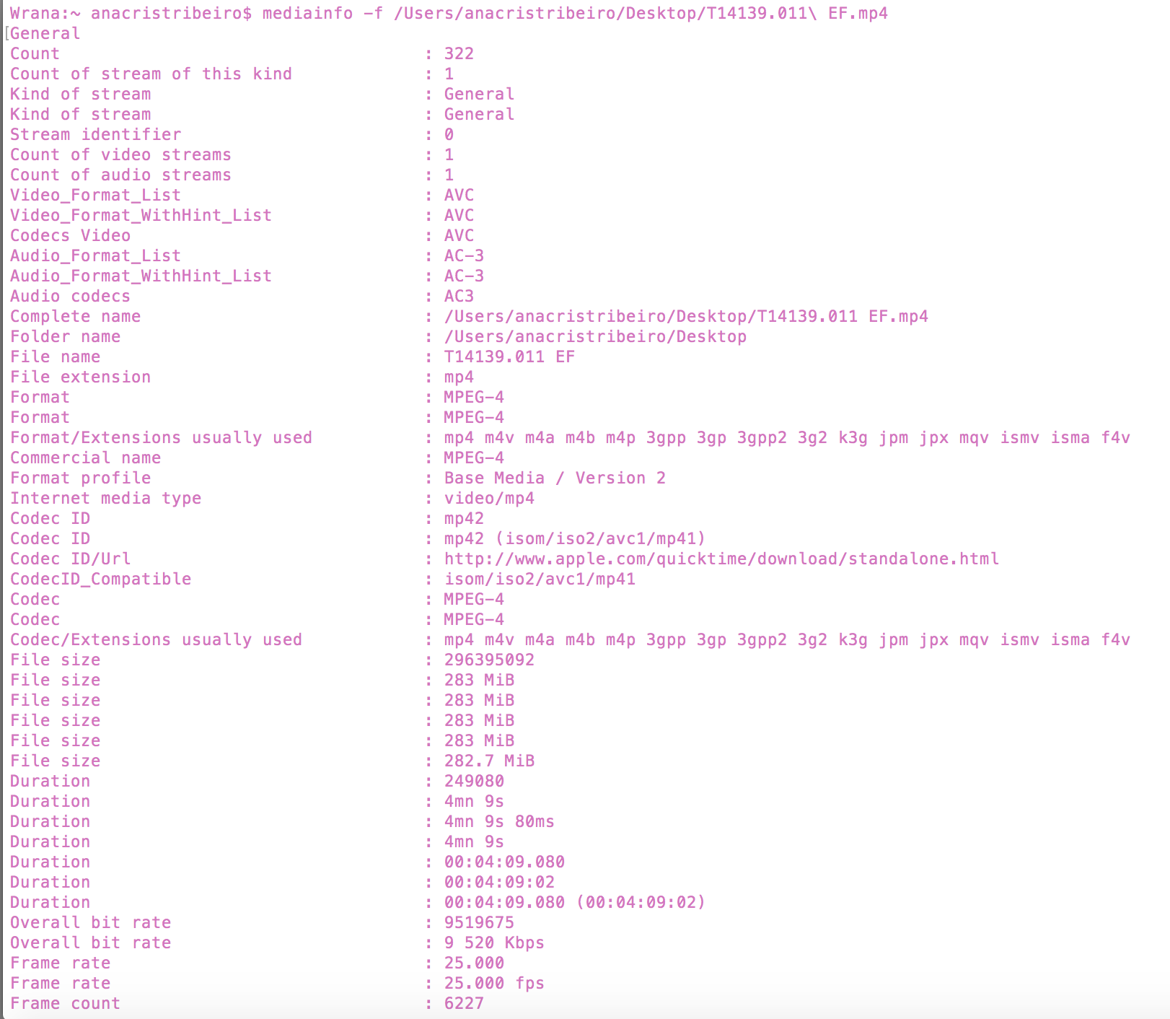
Media Info Reports

Slide 18
But what about all the detours?
How can we link a file prepared for a specific hardware and context back to the artwork in a more efficient way?

Slide 19
How to combine technical information and personal notes on decision making?
Screenshots - sometimes we use GUIs like HandBrake (+ annotations)
Outputting FFmpeg logs (+ annotations)
Combining files MediaInfo reports with information about treatments and storing them in our artwork folders - separate from the file. (inspired by the work of Agathe Jarczyk)
Aggregating technical reports and storing documentation in the container of our exhibition format files

Slide 20
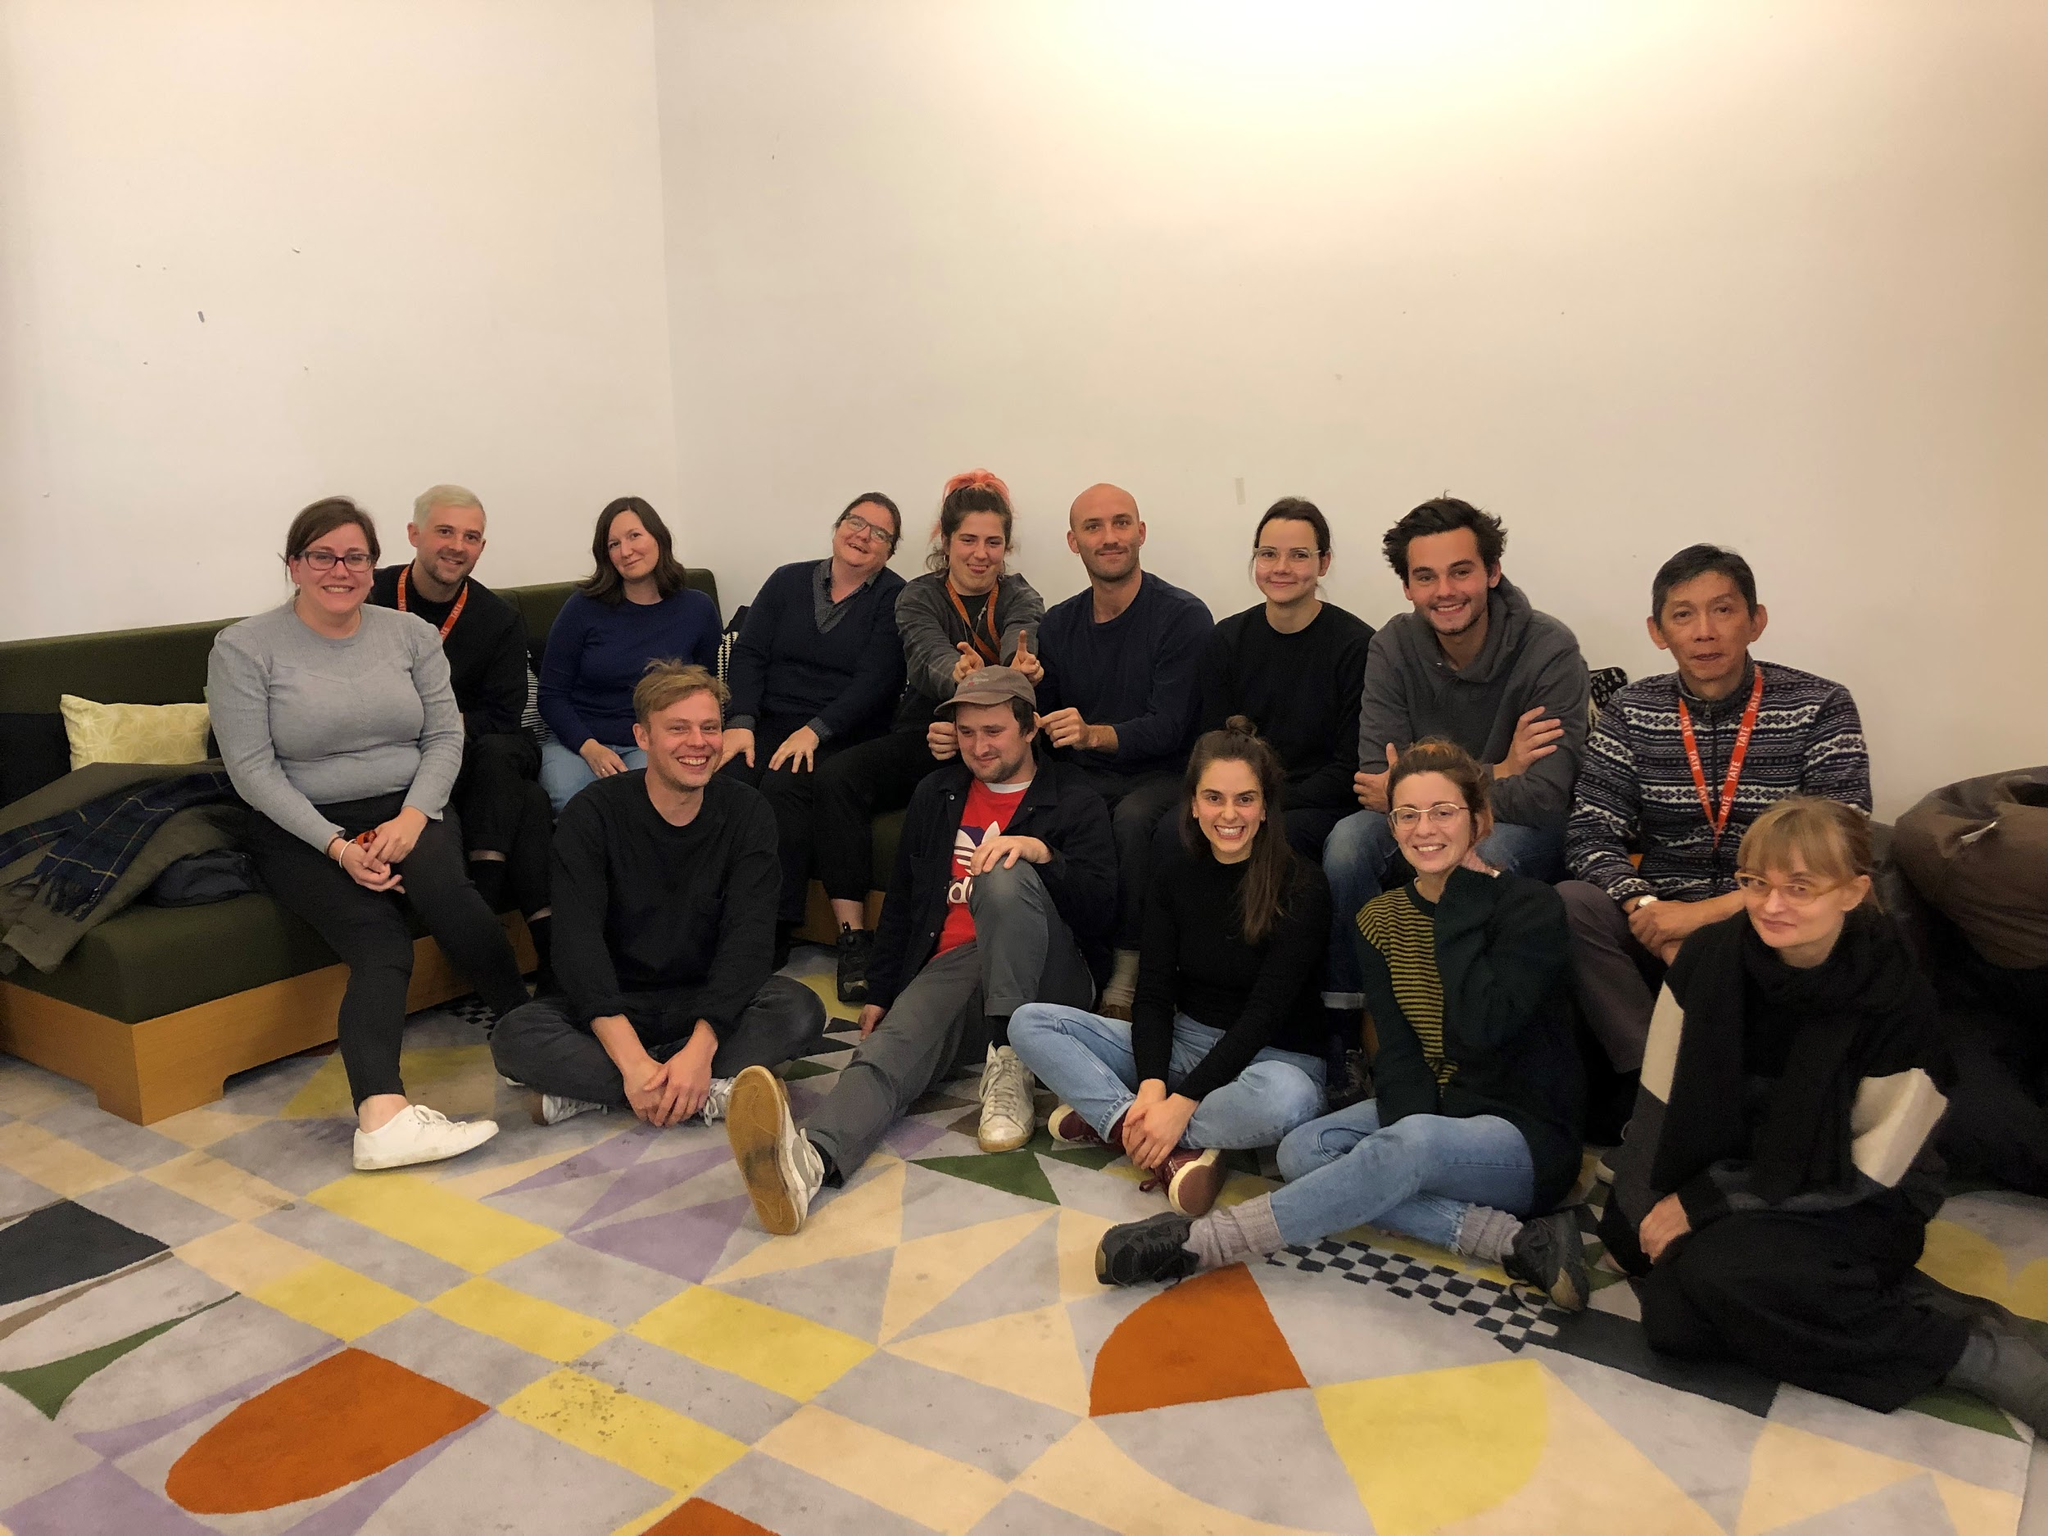

Slide 21
THANK YOU!
francesca.colussi@tate.org.uk | ana.ribeiro@tate.org.uk

